Slide 1
Graphs and Graph Algorithms 2

Slide 2
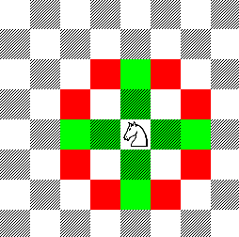
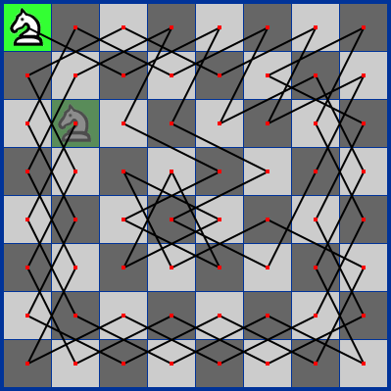
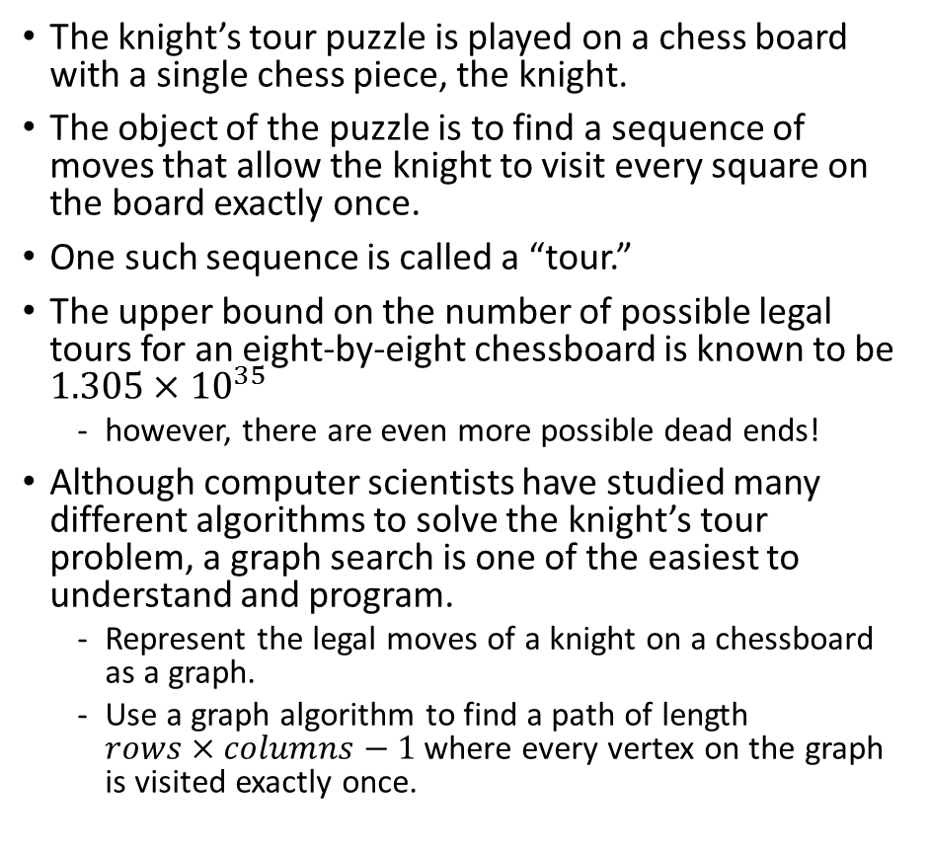
The Knight’s Tour Problem
The knight’s tour puzzle is played on a chess board with a single chess piece, the knight.
The object of the puzzle is to find a sequence of moves that allow the knight to visit every square on the board exactly once.
One such sequence is called a “tour.”
The upper bound on the number of possible legal tours for an eight-by-eight chessboard is known to be $1.305×{10}^{35}$
however, there are even more possible dead ends!
Although computer scientists have studied many different algorithms to solve the knight’s tour problem, a graph search is one of the easiest to understand and program.
Represent the legal moves of a knight on a chessboard as a graph.
Use a graph algorithm to find a path of length $rows×columns−1$where every vertex on the graph is visited exactly once.

Slide 3
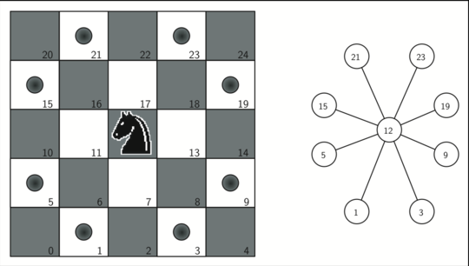
Building the Knight’s Tour Graph
To represent the knight’s tour problem as a graph we will use the following two ideas:
Each square on the chessboard can be represented as a node in the graph.
Each legal move by the knight can be represented as an edge in the graph.

Slide 4
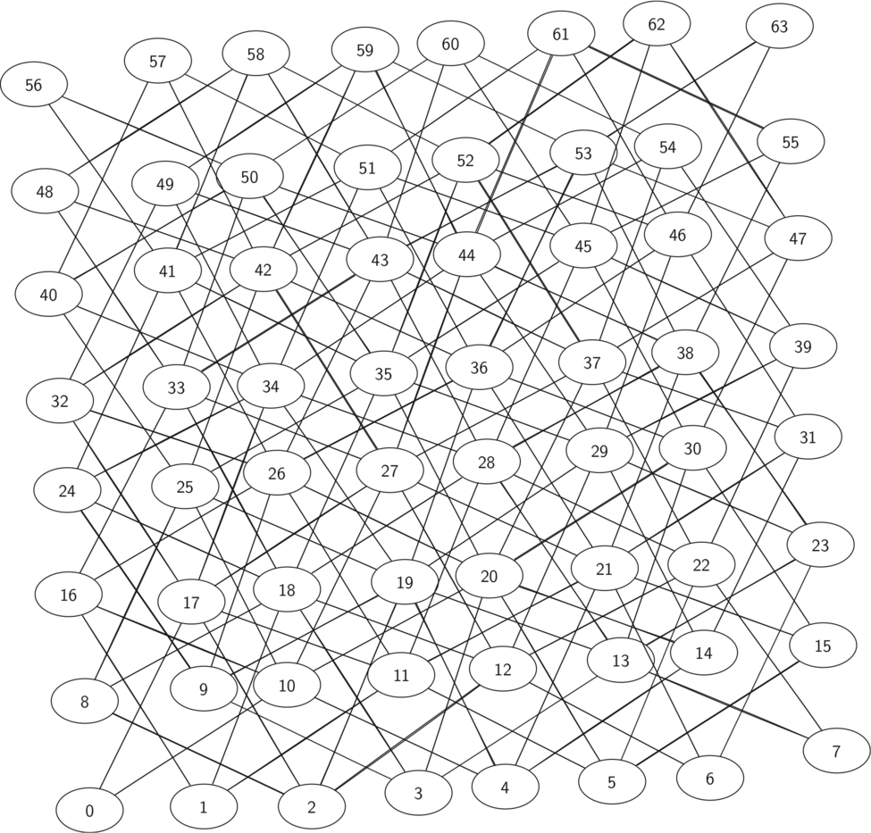
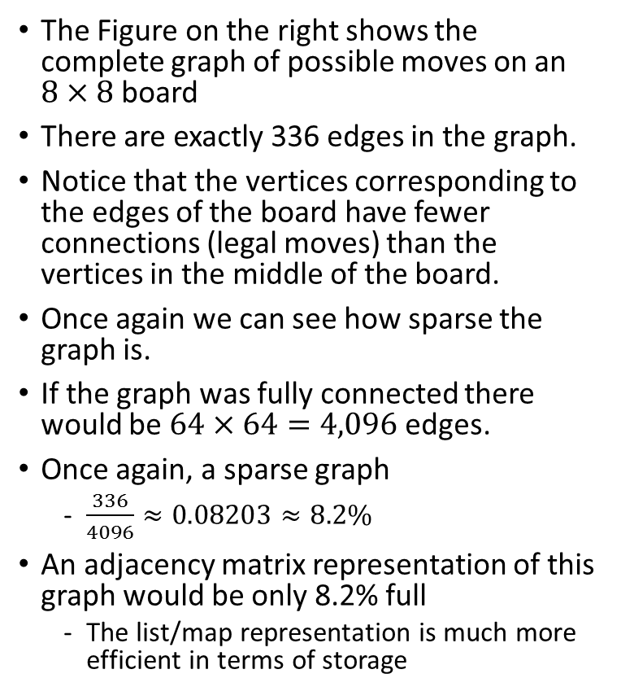
Complete graph of possible moves on an eight-by-eight board
The Figure on the right shows the complete graph of possible moves on an $8×8$ board
There are exactly 336 edges in the graph.
Notice that the vertices corresponding to the edges of the board have fewer connections (legal moves) than the vertices in the middle of the board.
Once again we can see how sparse the graph is.
If the graph was fully connected there would be $64×64=4,096$ edges.
Once again, a sparse graph
$\frac{336}{4096}≈0.08203≈8.2\%$
An adjacency matrix representation of this graph would be only 8.2% full
The list/map representation is much more efficient in terms of storage

Slide 5
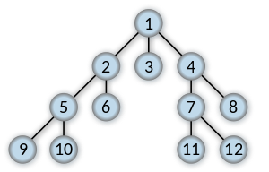
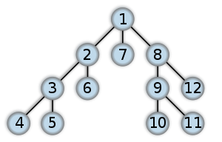
Breadth First Search and Depth First Search
Breadth-first search (BFS) is an algorithm for traversing or searching graph data structures.
Recall that a tree is just a type of graph
BFS starts at the tree root (or some arbitrary node of a graph), and explores all of the neighbor nodes at the present depth prior to moving on to the nodes at the next depth level.
This is in contrast to Depth-first search (DFS) another algorithm for traversing or searching a tree or graph data structures.
DFS starts at the root node (selecting some arbitrary node as the root node in the case of a graph) and explores as far as possible along each branch before backtracking.
Breadth-first search (BFS)
Depth-first search (DFS)

Slide 6
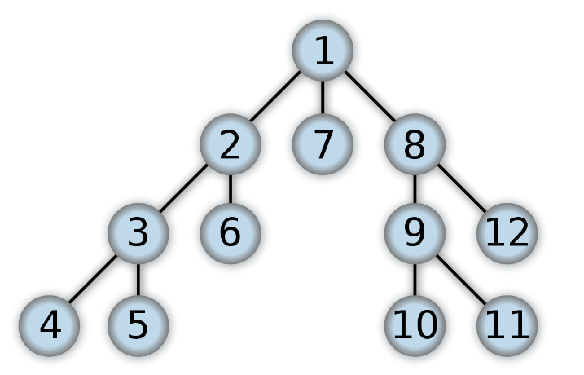
Implementing Knight’s Tour using depth first search (DFS)
The search algorithm we will use to solve the knight’s tour problem is called depth first search (DFS).
Whereas the breadth first search algorithm discussed in the previous class builds a search tree one level at a time, a depth first search creates a search tree by exploring one branch of the tree as deeply as possible.
The depth first exploration of the graph is exactly what we need in order to find a path that has exactly 63 edges.
We would never finish if we adopted a BFS approach
Why?
63 edges means the algorithm has visited all 64 vertices in the graph
When the depth first search algorithm finds a dead end (a place in the graph where there are no more moves possible) it backs up the tree to the previous deepest vertex that allows it to make a legal move.

Slide 7
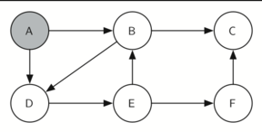
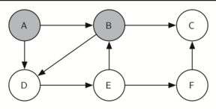

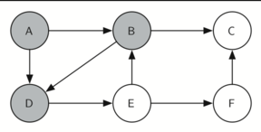
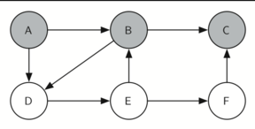
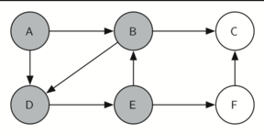
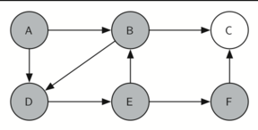
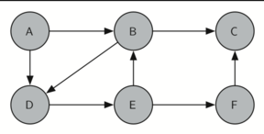
Finding a complete path through a graph with knightTour
a) Start with node A
b) Explore node B
c) Node C is a dead end
d) Backtrack to B
e) Explore next vertex
f) Explore node E
g) Explore node F
h) Explore node C and finish
DFS also uses flags/colors to keep track of which vertices in the graph have been visited.
Unvisited vertices are colored white, and visited vertices are colored gray.
If all neighbors of a particular vertex have been explored and we have not yet reached our goal length of 64 vertices, we have reached a dead end.
When we reach a dead end we must backtrack.

Slide 8
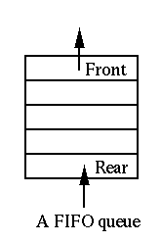
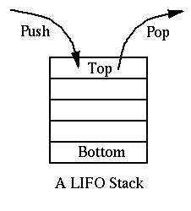
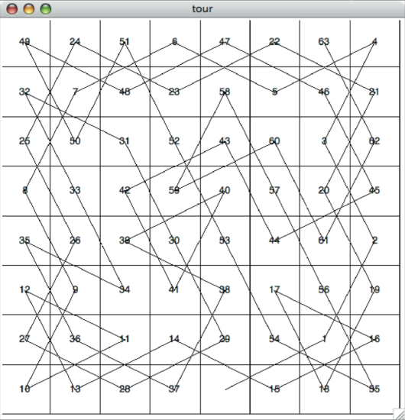
A complete tour of the board
In the breadth first search we used a queue to keep track of which vertex to visit next.
Since depth first search is recursive, we are implicitly using a stack to help us with our backtracking.

Slide 9
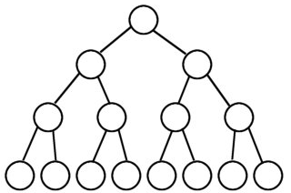
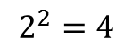
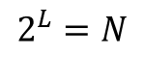
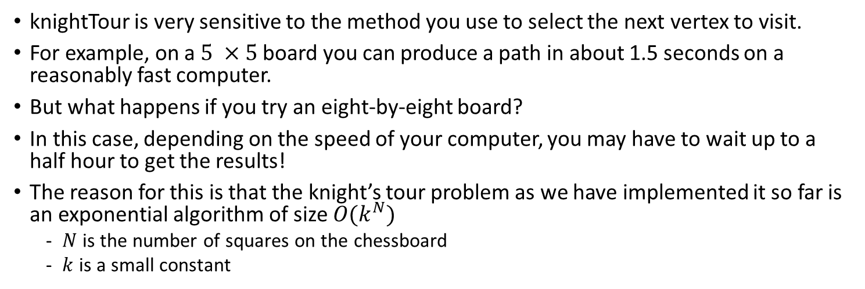
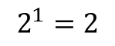
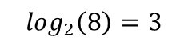
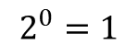
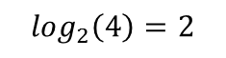
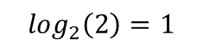
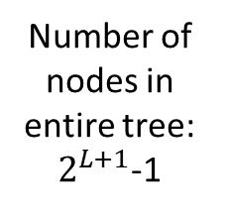
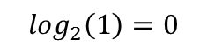
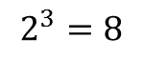
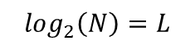
Knight’s tour analysis
knightTour is very sensitive to the method you use to select the next vertex to visit.
For example, on a $5 ×5$ board you can produce a path in about 1.5 seconds on a reasonably fast computer.
But what happens if you try an eight-by-eight board?
In this case, depending on the speed of your computer, you may have to wait up to a half hour to get the results!
The reason for this is that the knight’s tour problem as we have implemented it so far is an exponential algorithm of size $O(k^{N})$
$N$ is the number of squares on the chessboard
$k$ is a small constant
Number of nodes in level
Level
$$\log_{2}\left(1\right)=0$$
$$2^{0}=1$$
Height of the tree is logarithmic with respect to the number of nodes in last level
$$\log_{2}\left(2\right)=1$$
$$2^{1}=2$$
$$\log_{2}\left(4\right)=2$$
$$2^{2}=4$$
Number of nodes in entire tree: $2^{L+1}$-1
$$\log_{2}\left(8\right)=3$$
$$2^{3}=8$$
Number of nodes in level is exponential with respect to level
$$\log_{2}\left(N\right)=L$$
$$2^{L}=N$$
Notes:
Also, total number of nodes in three is $2^{H+1}$

Slide 10
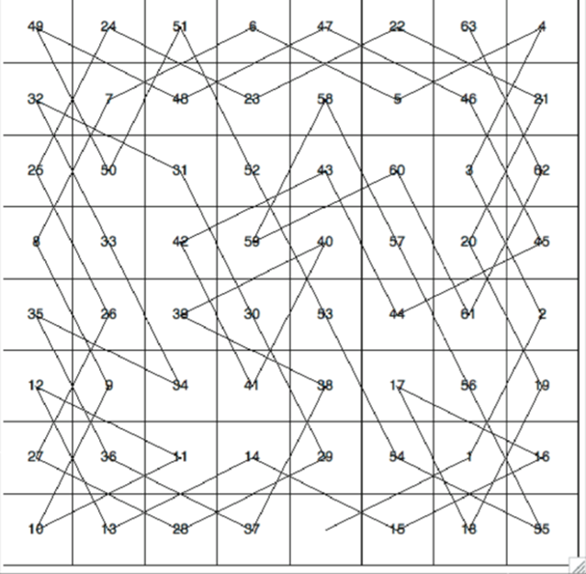
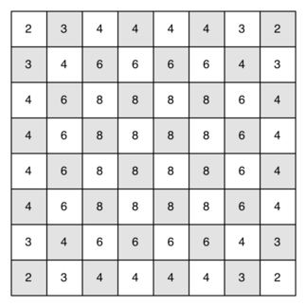
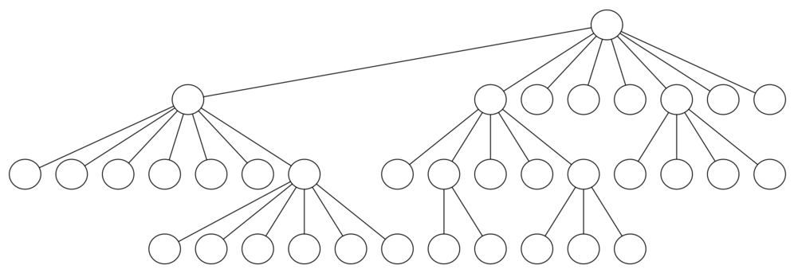
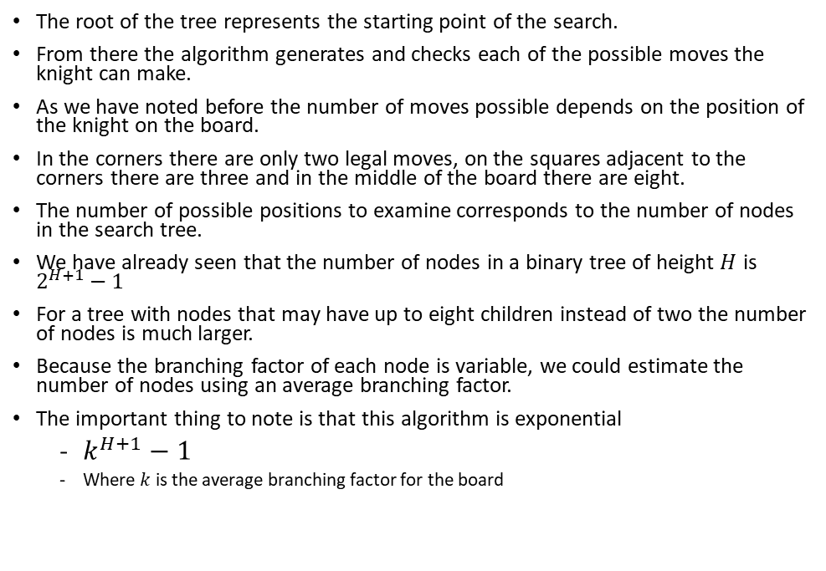
Knight’s Tour Analysis
The root of the tree represents the starting point of the search.
From there the algorithm generates and checks each of the possible moves the knight can make.
As we have noted before the number of moves possible depends on the position of the knight on the board.
In the corners there are only two legal moves, on the squares adjacent to the corners there are three and in the middle of the board there are eight.
The number of possible positions to examine corresponds to the number of nodes in the search tree.
We have already seen that the number of nodes in a binary tree of height $H$ is $2^{H+1}−1$
For a tree with nodes that may have up to eight children instead of two the number of nodes is much larger.
Because the branching factor of each node is variable, we could estimate the number of nodes using an average branching factor.
The important thing to note is that this algorithm is exponential
$k^{H+1}−1$
Where $k$ is the average branching factor for the board

Slide 11
Knight’s Tour Analysis
Luckily there is a way to speed up the algorithm
Prioritize searching nodes with less number of edges (number of possible moves)
Pushes the algorithm to visit first the difficult squares around the edges of the board
More details in the practical
This ensures that the knight will visit the hard-to-reach corners early and can use the middle squares to hop across the board only when necessary.
Utilizing this kind of insider knowledge about the problem at hand to speed up an algorithm is called a heuristic.

Slide 12
General Depth First Search
The knight’s tour is a special case of a depth first search where the goal is to create the deepest depth first tree, without any branches.
The more general depth first search is actually easier.
Its goal is to search as deeply as possible, connecting as many nodes in the graph as possible and branching where necessary.
It is even possible that a depth first search will create more than one tree.
When the depth first search algorithm creates a group of trees we call this a depth first forest.
As with the breadth first search, our depth first search makes use of predecessor links to construct the tree.
The depth first search will make use of two additional instance variables in the Vertex class.
The discovery time tracks the number of steps in the algorithm before a vertex is first encountered.
The finish time is the number of steps in the algorithm before a vertex is colored black.
As we will see after looking at the algorithm, the discovery and finish times of the nodes provide some interesting properties we can use in advanced graph algorithms.

Slide 13
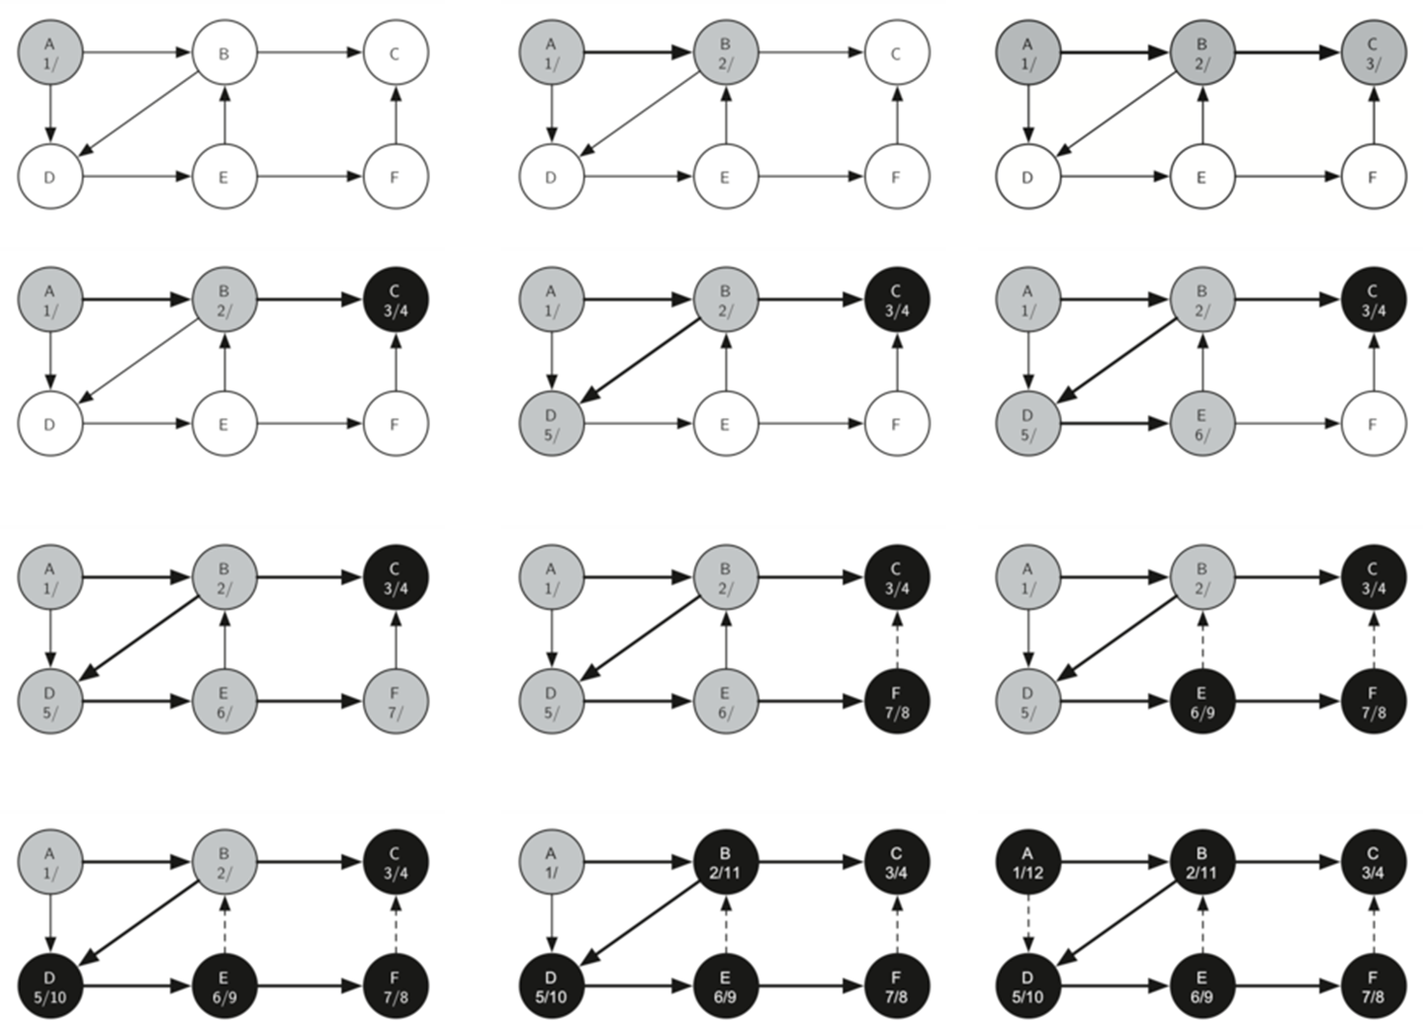
Notes:
General Depth First Search

Slide 14
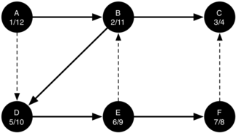
The parenthesis property
The starting and finishing times for each node display a property called the parenthesis property.
This property means that all the children of a particular node in the depth first tree have a later discovery time and an earlier finish time than their parent.

Slide 15
Applications of Depth First Search
1) For an unweighted graph, DFS traversal of the graph produces the minimum spanning tree and all pair shortest path tree.
2) Detecting cycles in a graph A graph has cycle if and only if we see a back edge during DFS. So we can run DFS for the graph and check for back edges. (See this for details)
3) Path Finding We can specialize the DFS algorithm to find a path between two given vertices u and z. i) Call DFS(G, u) with u as the start vertex. ii) Use a stack S to keep track of the path between the start vertex and the current vertex. iii) As soon as destination vertex z is encountered, return the path as the contents of the stack
4) Topological Sorting Topological Sorting is mainly used for scheduling jobs from the given dependencies among jobs. In computer science, applications of this type arise in instruction scheduling, ordering of formula cell evaluation when recomputing formula values in spreadsheets, logic synthesis, determining the order of compilation tasks to perform in makefiles, data serialization, and resolving symbol dependencies in linkers.
5) To test if a graph is bipartite We can augment either BFS or DFS when we first discover a new vertex, color it opposited its parents, and for each other edge, check it doesn’t link two vertices of the same color. The first vertex in any connected component can be red or black! See this for details.
6) Finding Strongly Connected Components of a graph A directed graph is called strongly connected if there is a path from each vertex in the graph to every other vertex. (See this for DFS based algo for finding Strongly Connected Components) 7) Solving puzzles with only one solution, such as mazes. (DFS can be adapted to find all solutions to a maze by only including nodes on the current path in the visited set.)

Slide 16
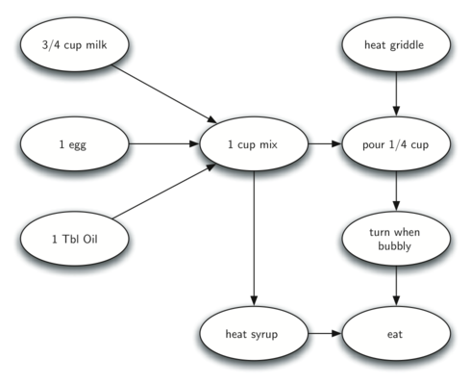
Topological sorting
Let’s think about how to make pancakes
The difficult thing about making pancakes is knowing what to do first.
As you can see in the Figure (a graph version of a recipe for making pancakes) you might start by heating the griddle or by adding any of the ingredients to the pancake mix.
To help us decide the precise order in which we should do each of the steps required to make our pancakes we turn to a graph algorithm called the topological sort.

Slide 17
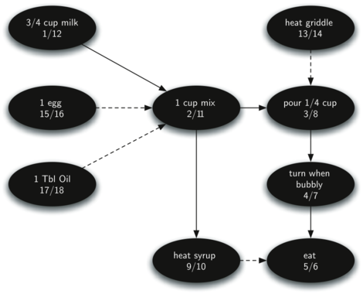
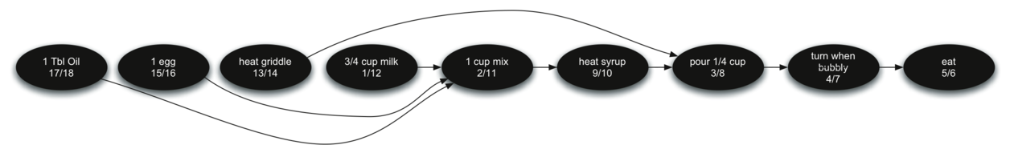
Topological sorting
A topological sort takes a directed acyclic graph and produces a linear ordering of all its vertices such that if the graph G contains an edge (v,w) then the vertex v comes before the vertex w in the ordering.
Directed acyclic graphs are used in many applications to indicate the precedence of events.
Making pancakes is just one example; other examples include software project schedules, precedence charts for optimizing database queries, and multiplying matrices in artificial intelligence models.
The Figure on the right shows the depth first forest constructed by dfs on the pancake-making graph
The topological sort is a simple but useful adaptation of a depth first search. The algorithm for the topological sort is as follows:
Call dfs(g) for some graph g. The main reason we want to call depth first search is to compute the finish times for each of the vertices.
Store the vertices in a list in decreasing order of finish time.
Return the ordered list as the result of the topological sort.
Notes:
The bottom figure shows the results of applying the topological sort algorithm to our graph.
Now all the ambiguity has been removed and we know exactly the order in which to perform the pancake making steps.

Slide 18
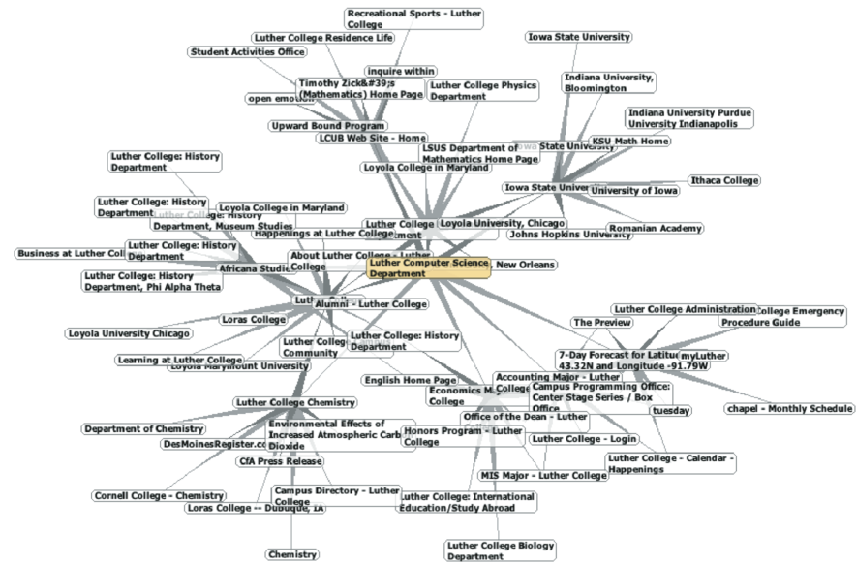
Strongly Connected Components
Search engines like Google and Bing exploit the fact that the pages on the web form a very large directed graph.
To transform the World Wide Web into a graph, we will treat a page as a vertex, and the hyperlinks on the page as edges connecting one vertex to another.

Slide 19
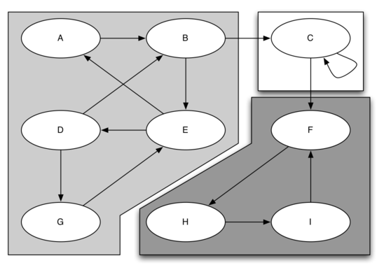
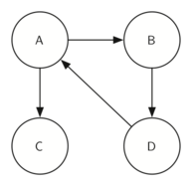
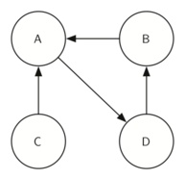
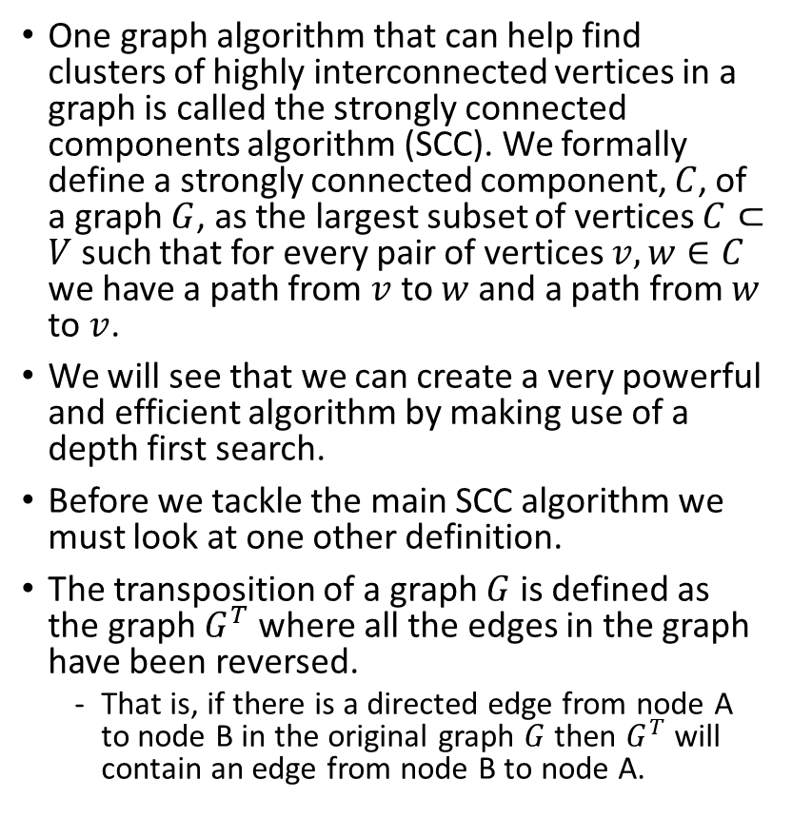
Strongly Connected Components
One graph algorithm that can help find clusters of highly interconnected vertices in a graph is called the strongly connected components algorithm (SCC). We formally define a strongly connected component, $C$, of a graph $G$, as the largest subset of vertices $C⊂V$ such that for every pair of vertices $v,w∈C$ we have a path from $v$ to $w$ and a path from $w$ to $v$.
We will see that we can create a very powerful and efficient algorithm by making use of a depth first search.
Before we tackle the main SCC algorithm we must look at one other definition.
The transposition of a graph $G$ is defined as the graph $G^{T}$ where all the edges in the graph have been reversed.
That is, if there is a directed edge from node A to node B in the original graph $G$ then $G^{T}$ will contain an edge from node B to node A.

Slide 20
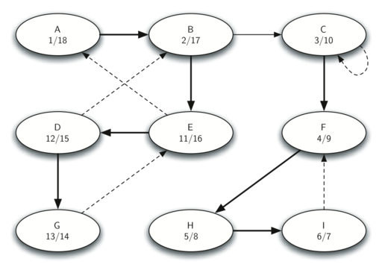
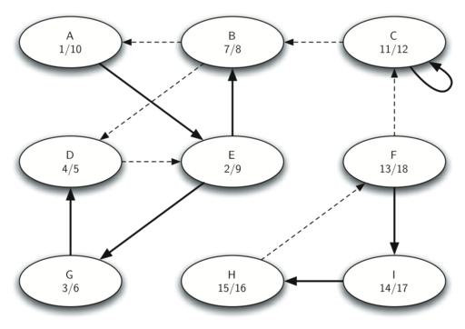
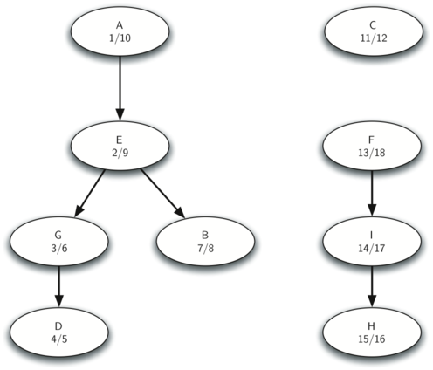
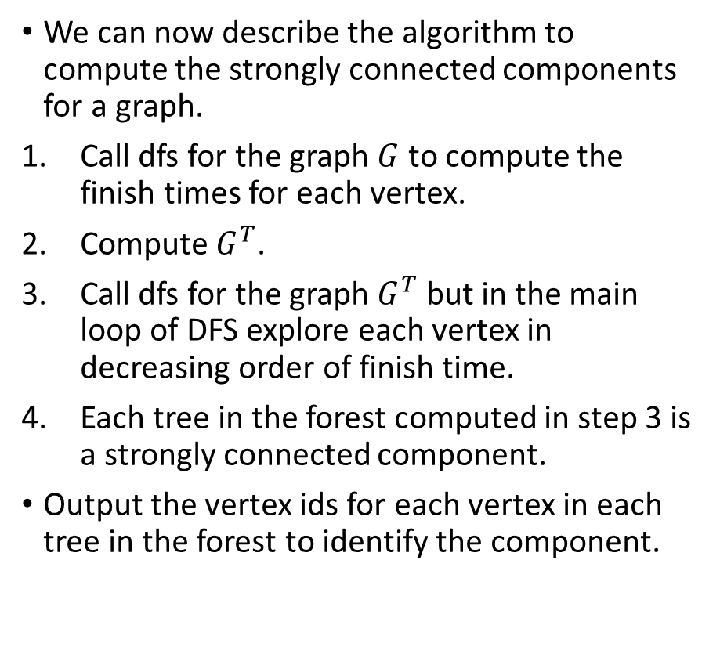
Strongly Connected Components
We can now describe the algorithm to compute the strongly connected components for a graph.
Call dfs for the graph $G$ to compute the finish times for each vertex.
Compute $G^{T}$.
Call dfs for the graph $G^{T}$ but in the main loop of DFS explore each vertex in decreasing order of finish time.
Each tree in the forest computed in step 3 is a strongly connected component.
Output the vertex ids for each vertex in each tree in the forest to identify the component.

Slide 21


Shortest Path Problems
The figure on the bottom right shows a small example of a weighted graph that represents the interconnection of routers in the Internet.
The problem that we want to solve is to find the path with the smallest total weight along which to route any given message.
This problem should sound familiar because it is similar to the problem we solved using a breadth first search, except that here we are concerned with the total weight of the path rather than the number of hops in the path.
It should be noted that if all the weights are equal, the problem is the same.

Slide 22

Dijkstra’s Algorithm
Dijkstra’s algorithm is an iterative algorithm that provides us with the shortest path from one particular starting node to all other nodes in the graph.
To keep track of the total cost from the start node to each destination we will make use of the dist instance variable in the Vertex class.
The dist instance variable will contain the current total weight of the smallest weight path from the start to the vertex in question.
The value that is used to determine the order of the objects in the priority queue is dist.

